Slide 1


Multi-omics Boot Camp
Analysis of Omics Data for Research Studies
Clustering
Kimberly Siegmund
Instructor, USC
Qiran Jia
Workshop Guide, USC

Slide 2
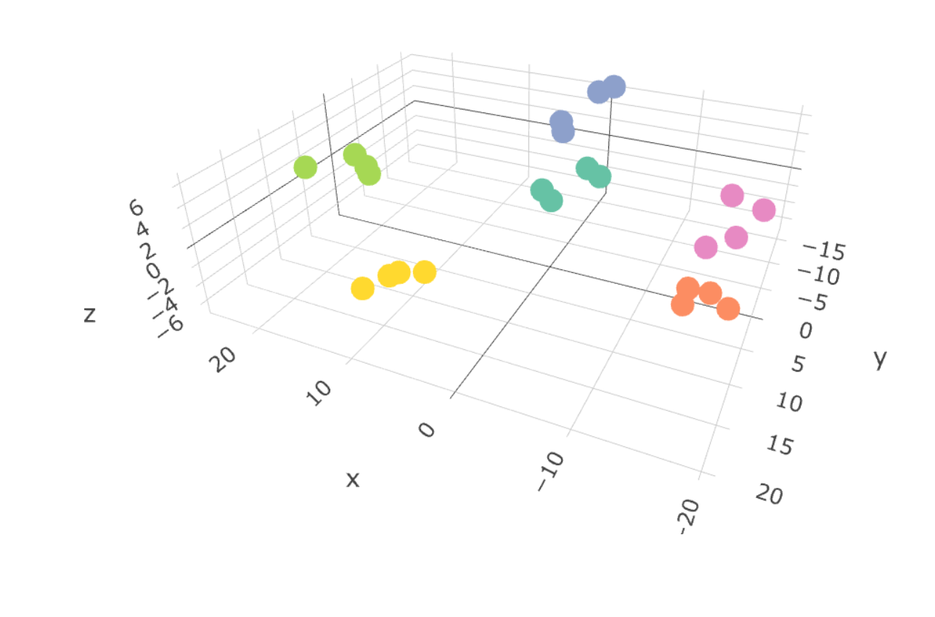
Goals
To visualize data using
Dimension reduction method
Principal component analysis
Canonical Correlation Analysis
Cluster Analysis
Hierarchical clustering
Partitioning methods
Notes:
To describe the key steps for performing these

Slide 3
Data visualization is an important first step to data exploration
Notes:
Critical for high-dimensional data, and it includes the data QC.

Slide 4
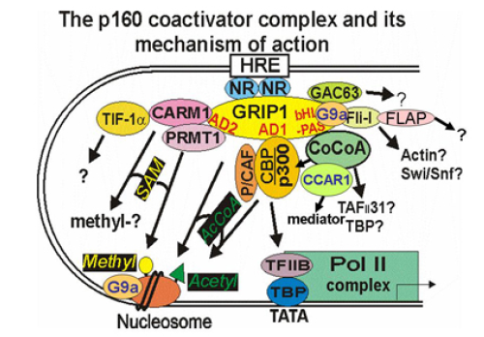
Identify Androgen Regulated Genes
Gene Expression
After Androgen (DHT)
 | 0 hr | 16 hr
siNS (control) | 4 | 4
siCBP | 4 | 4
sip300 | 4 | 4
Stallcup Lab, USC
GEO accession: GSE31873
Notes:
The data I will show come from a lab that studies how hormones regulate gene expression.
This picture shows the complex activity at a gene’s transcription start site
The ovals in this picture represent proteins
One way to study the regulation is to remove a protein and measure the change in gene expression.
The data we’ll study came from knock-down experiments performed in prostate cancer cell line growing in culture,
On the right the table shows the 3x2 factorial design:
We have 3 treatments; control reaction, and p300 and CBP knockdowns.
These cells are treated with DHT and measured at time 0 and16 hrs later.
The experiment was replicated 4 times.
Which genes regulated by androgen require the proteins p300 over CBP for their regulation?
24 Illumina HumanHT-12 V4.0 arrays, GEO accession: GSE31873
4 replicates of each treatment group: Non-specific control knockdown, CBP knockdown, p300 knockdown,
Cells measured immediately after giving androgen and 16 hours later.

Slide 5
Data
p features
D(a,b)
Pairwise
Dissimilarity
n-1 dissimilarities
Dissimilarity for QC:
Median (| y_{af} – y_{bf} |)
n samples
Notes:
1st step with any analysis is data cleaning, and we need to learn how to identify outliers in high-dimensional setting.
I want to move on to the methods you’d rather hear discussed, but I did want to emphasize the importance of identifying/removing problematic data.
We can use color to visualize the dissimilarities between samples. I am happy to answer questions about this during discussion. Dissimilarity

Slide 6
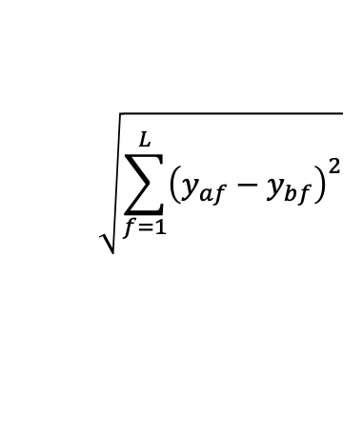
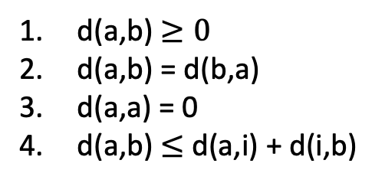
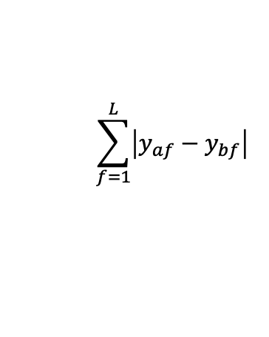
Distance Metrics
a
4 Properties
d(a,b) $≥0$
d(a,b) = d(b,a)
d(a,a) = 0
d(a,b) $≤$ d(a,i) + d(i,b)
b
i
$$\sqrt{\sum_{f=1}^{L}{{\left(y_{af}−y_{bf}\right)}^{2}}}$$
$$\sum_{f=1}^{L}{\left|y_{af}−y_{bf}\right|}$$
Euclidean
Manhattan

Slide 7
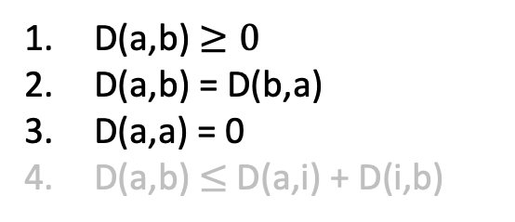
Dissimilarity
Examples:
1 – cor(a,b)
1 – abs(cor(a,b))
Pairwise correlation = 0.7
3 Properties
D(a,b) $≥0$
D(a,b) = D(b,a)
D(a,a) = 0
D(a,b) $≤$ D(a,i) + D(i,b)
Notes:
Correlations can be pearson, Spearman, Kendall’s tau

Slide 8
Visualize Biological Patterns
Dimension Reduction Techniques
Principal Components Analysis
Canonical Correlation Analysis (2 data sets)
Cluster Analysis
Hierarchical cluster analysis
Partitioning Methods

Slide 9
Dimension Reduction
Data
Principal Components Analysis

Slide 10
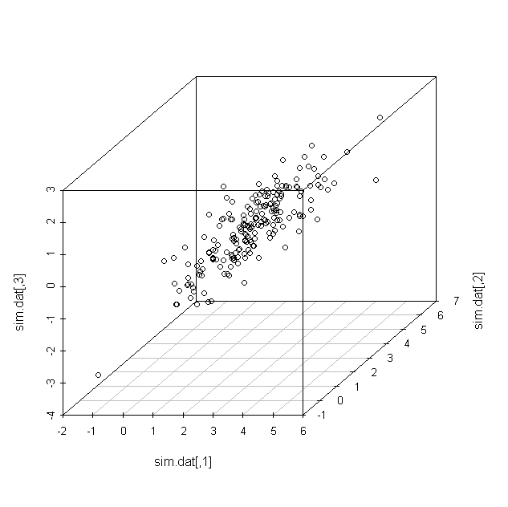
Principal Components Analysis (PCA)
p features
L features
Data
Data

Slide 11
PCA is Rotation of Original Variables to explain maximum Variation
PC2
PC1
Notes:
Let’s see what this would look like for 2 genes measured on our 24 sample arrays.
Principal components can be obtained from a singular value decomposition of the centered data matrix (X)

Slide 12
Singular Value Decomposition (n>p)
D_{pxp}
U^{T}U = I
V^{T}V = I
X_{nxp}
=
U_{nxp}
V^{T}_{pxp}
Rotation
Columns
Mean 0
Eigenvectors d² = eigenvalues
d₁ > d₂ > … > d_{p}
PC1, PC2, PC3, …
X_{nxp}
V_{pxp}
U_{nxp}
D_{pxp}
=
U_{Nxp}
=
PC_{nxp}
Notes:
The loadings are the Eigen vectors.
The rotation is determined by the eigenvectors, u_{i}, of the covariance matrix, Σ_{2x2}.
PCs are uncorrelated (PC_{i}= X^{T}v).

Slide 13
High Dimensional PCA
47,231 features
500 most variable features
Alternative: Sparse PCA using penalization

Slide 14
PCA of Helix Exposome Data
88 exposures during pregnancy
1170 mom-child pairs
SHARP.Clustering.PartI.Rmd

Slide 15
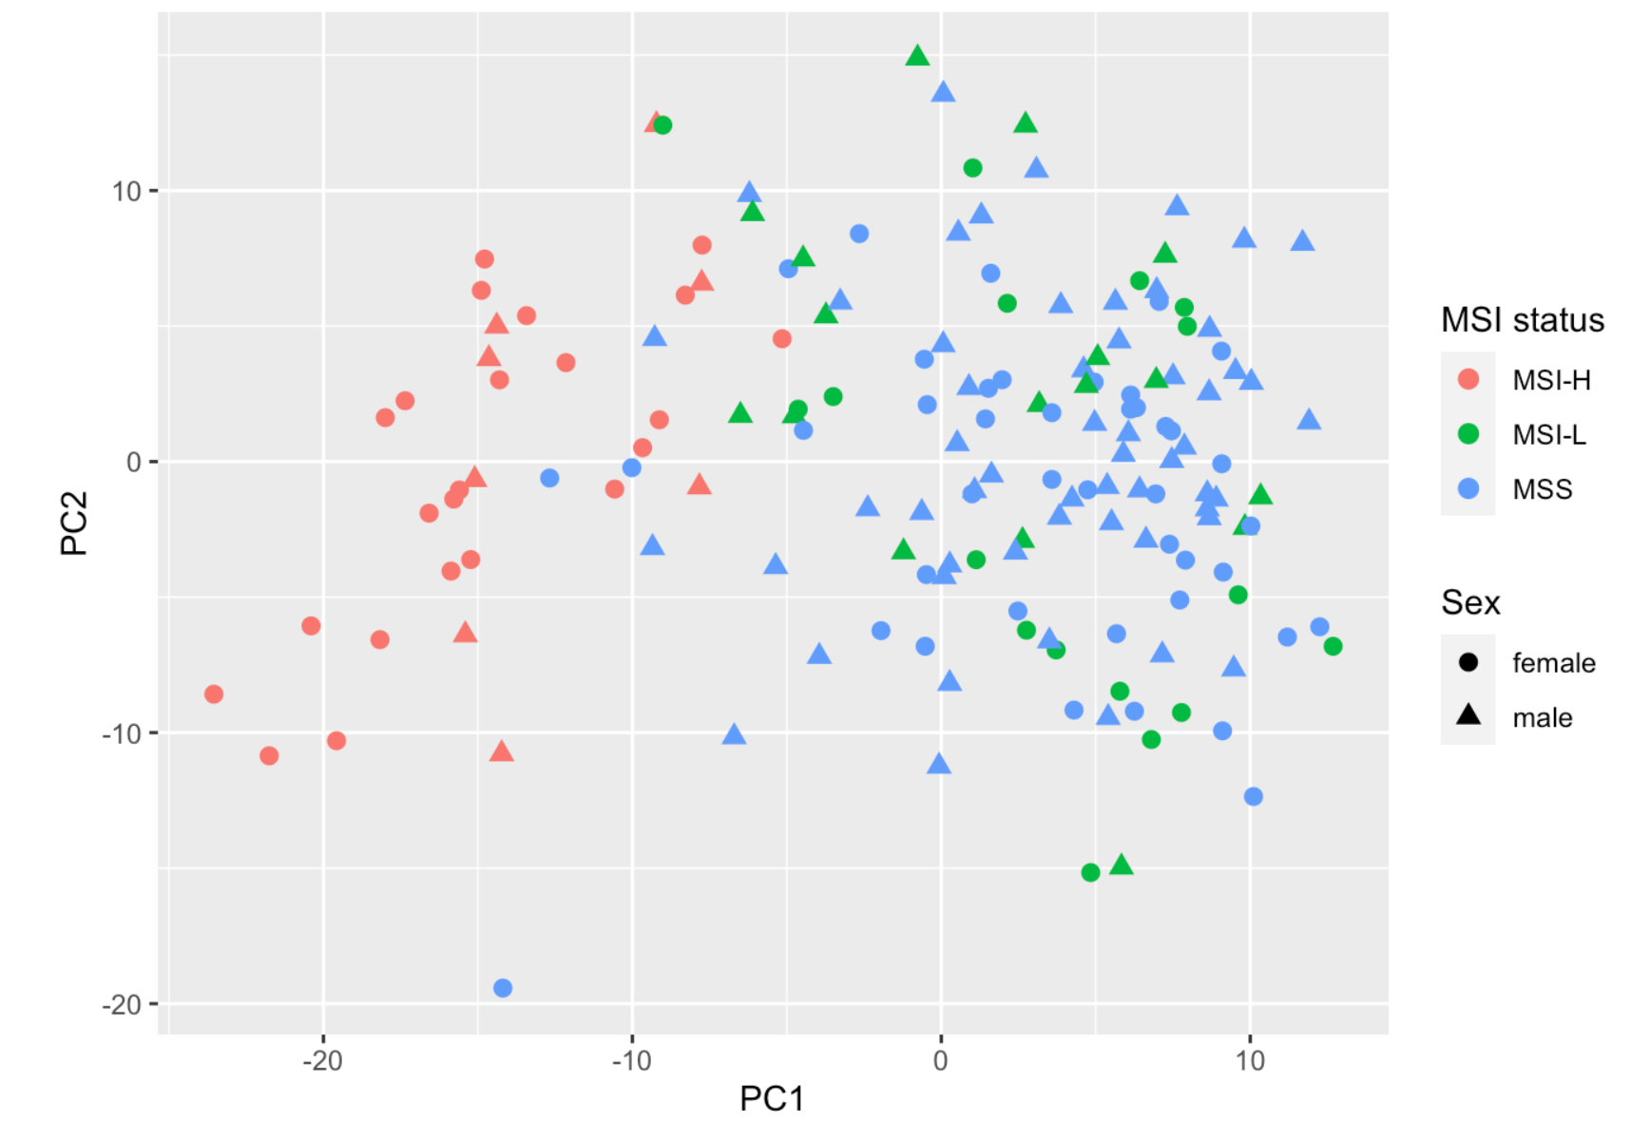
The Cancer Genome Atlas
163 colon adenocarcinomas
log2-expression
top 500 variable genes
SHARP.Clustering.COAD.Rmd

Slide 16
Summary
PCA is a linear dimension reduction technique, that works on the global space
Distinct groups may be better captured after initial filtering of features on variance

Slide 17
Hierarchical Clustering and Partitioning Methods

Slide 18
Single linkage
Complete linkage
Minimize
RSS
Average linkage
Ward’s method

Slide 19
Analysis:
Select Features
Standardize features
Pick dissimilarities
Between samples
Between clusters

Slide 20
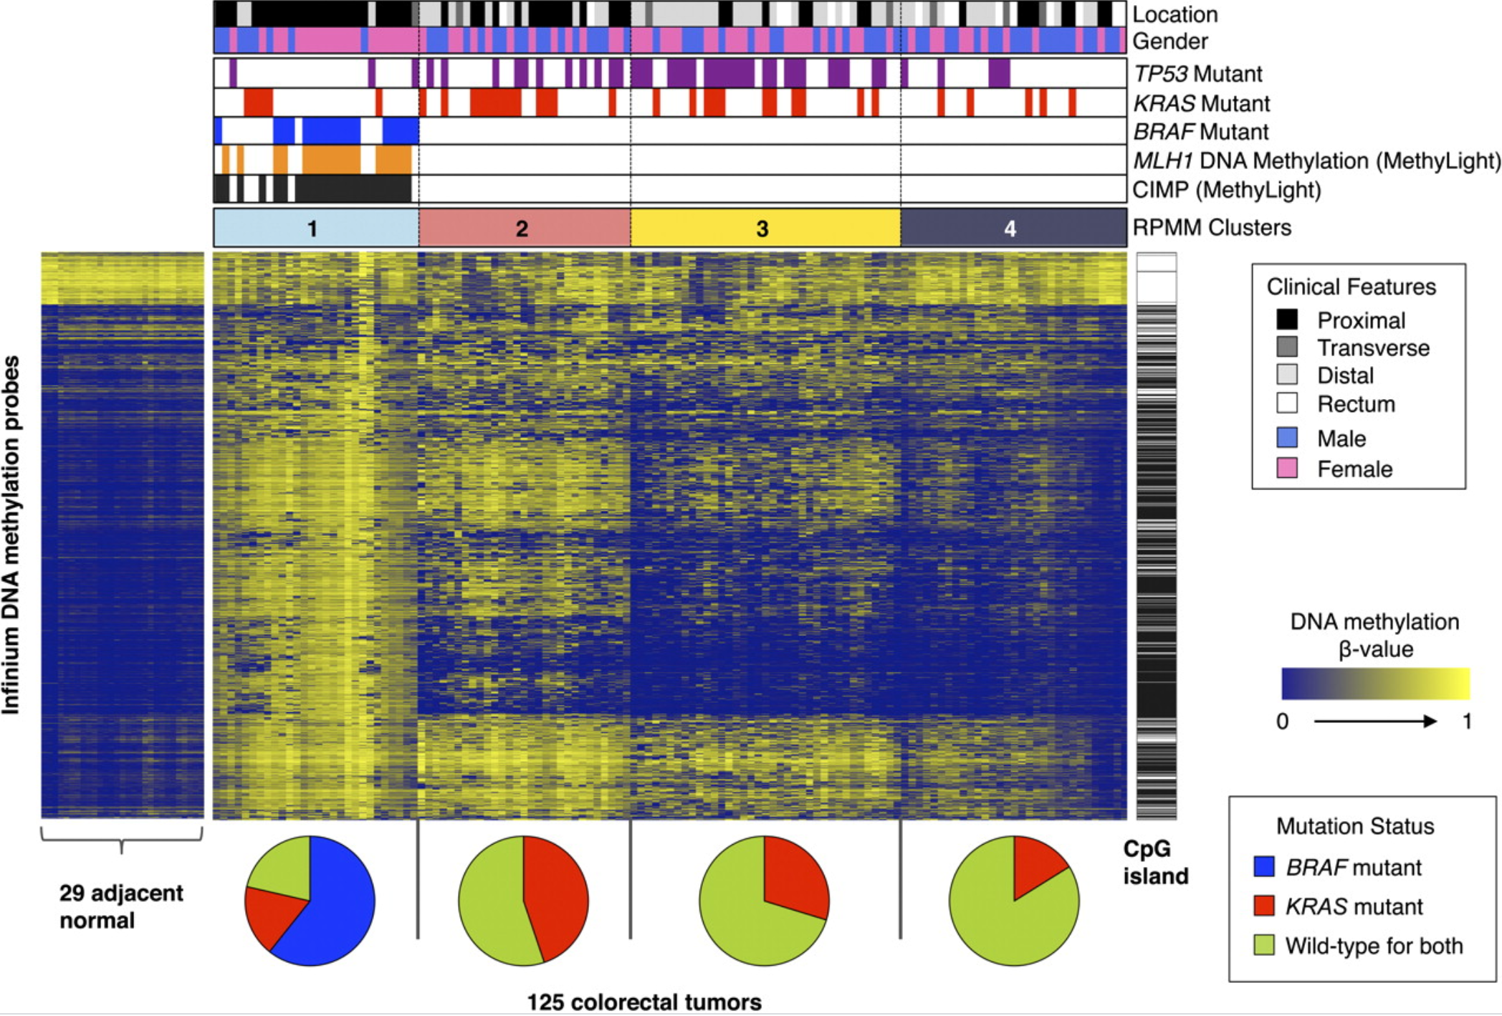
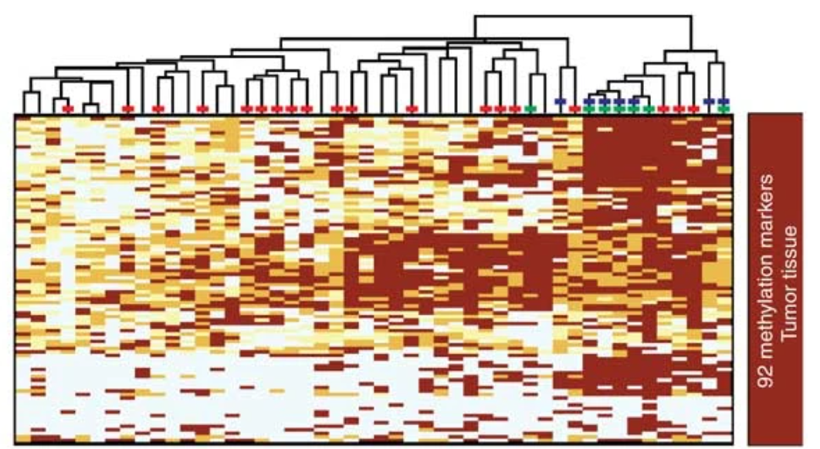
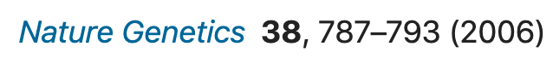

Colon adenocarcinoma: CpG island methylator phenotype

Slide 21
Partitioning Method: K-means
Step 0. Pick k (# groups), assign observations to groups
Step 1. Compute centroid,
the average value for each variable in cluster
Step 2. Assign observation to nearest centroid.
Go back to Step 1. until convergence
WARNING!! Often, the solution is not unique
Option 1. Repeat algorithm with random starts and save best solution
Option 2. Convex clustering (Chi EC and Lange K. Journal Comp Graph Stat 2015)
Notes:
K-means is a method that has been around for decades.
Step 0 is the initialization step. Pick k, the number of groups, and assign observations to that many groups.
Step 1 is compute the centroid, the average value for each variables in the cluster.
Step 2 is to re-assign the observations to the nearest centroid.
Nearest is defined by Euclidean Distance
Best means it has the lowest within-cluster sum of squares (Euclidean distance).
SOLUTION in low-dimensional setting: Splitting methods for convex clustering.
(Chi EC and Lange K. Journal Comp Graph Stat 2015)

Slide 22
Picking the # of clusters
Direct Method Testing method
Notes:
Partitioning methods require that we pick the number of clusters. There are many approaches. Here are two.
The one on the left is calculating a criterion, here, Average silhouette width
The method on the right assesses evidence against a specific null hypothesis, higher is better, and the method they recommend for selecting k would pick 4.

Slide 23
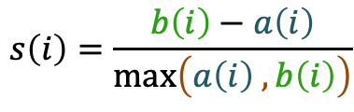
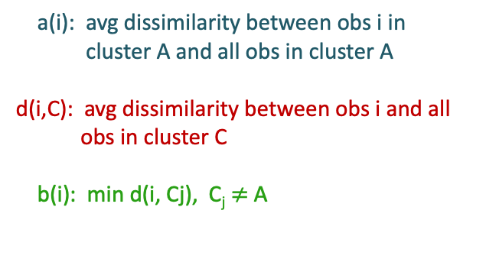
Pick # of clusters: Silhouette width
Cluster C₁
a(i): avg dissimilarity between obs i in
cluster A and all obs in cluster A
d(i,C): avg dissimilarity between obs i and all
obs in cluster C
b(i): min d(i, Cj), C_{j} $≠$A
Cluster C₂
Silhouette Width:
$$s\left(i\right)=\frac{b\left(i\right)−a\left(i\right)}{max⁡\left(a\left(i\right) ,b\left(i\right)\right)}$$
Cluster A
Notes:
b(i) is average dissimiliarity of object i (in cluster A) to the ‘nearest’ cluster that it is not in
S(i) measures how well matched an object is to the elements from its own cluster compared to how well matched if it were moved to the next closest cluster
s(i) lies between -1 and 1.
s(i) ≈1 then object is well classified
s(i) ≈ 0 lies between 2 clusters
s(i) ≈ -1 the object is poorly classified

Slide 24
Visualizing the K-means result (k=4)
Notes:
Going back to our Prostate cancer cell line data we have been analyzing.
We can plot the data in a lower-dimensional space, on the left I’ve plotted the data in the first 2 PCs, and color the samples by cluster.
Or display the data in a heatmap, and cluster the sample columns by the result of the k-means clustering. This data is interesting.
Only 3 clusters appear for the columns because their result does not optimize the WSS criterion, Instead it performs an analysis of repeated results to identify “consensus clusters”.

Slide 25
Influential Decisions
Feature selection & standardization
Number of clusters
Dissimilarity measure

Slide 26
Summary
Cluster analysis is an exploratory tool
The findings will require validation
ENVIRONMENT
ENVIRONMENT
Omic
Data
GENOTYPE
PHENOTYPE
Notes:
It is NOT a final analysis.

Slide 27
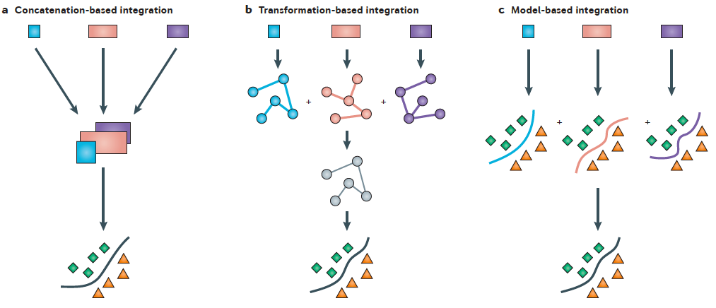
Approaches for Integrating Data
Ritchie et al. (2015) Nat Rev Genet
Concatenation-based Transformation-based Model-based
Blue, orange, purple boxes denote different data types
Notes:
They describe three different approaches for integrating the data, concatenation-based, transformation-based and model-based.
For each of these models the Blue, orange and purple boxes denote different data types.
For Concatenation-based, they just concatenate all variables from the different platforms to predict phenotype. All features are treated similarly, and the problem is very high-dimensional.
In the transformation-based approach, might use perform dimension reduction for individual data types before combining across data types.
Model-based builds models from single data types before building a model from models.

Slide 28
Canonical Correlation Analysis
Linear Combination Set 2 variables
Linear Combination Set 1 variables

Slide 29
Canonical Correlation Analysis (CCA)
X_{nxp}
Z_{nxq}
Helix Data
Postnatal Exposome: 132 Postnatal variables
Proteome: 36 proteins
Covariates: cohort, sex, child’s age, …
Phenotypes: asthma, bmi, intelligence quotient, …
Q: How do the sets of variables relate?
n samples
Notes:
Here is an example using the Helix data. A researcher collects 2 sets of variables.
Set 1 is exposome
Set 2 is Proteome
Then the question is how are these 2 sets of variables related?

Slide 30
CCA
Hotelling, Biometrika (1936)
Goal: Find linear combinations of (X,Z) that are maximally correlated
X_{nxp}
Set 1
Z_{nxq}
Set 2
Linear Combination Set 2 variables
n samples
Linear Combination Set 1 variables
Notes:
The goal of canonical correlation analysis (CCA) is to Find linear combinations of our sets of variables (X,Y) that are maximally correlated
X_{p} and Y_{q} represent 2 sets of measurements on the same n samples.
CCA assumes multivariate normality for X, Y.
And is not recommended for small n, since n is the number of points in our correlation plot.

Slide 31
CCA
Goal: Find linear combinations of (X,Z) that are maximally correlated
X_{nxp}
a
Z_{nxq}
b
Xa
Zb
b^{T}_{h}b_{h}=1
a^{T}_{h}a_{h}=1
nxH
Step 1. Columns of X, Z, Mean 0, var 1
Step 2. solve for a, b such that
…
arg max cor(Xa_{h}, Zb_{h}), h=1,…,H
Zb₁
Zb₂
= max a^{T}X^{T}Zb subject to a^{T}X^{T}Xa = b^{T}Z^{T}Zb = 1
Xa₁
Xa₂
Notes:
The analysis looks like this:
Step 1 is to standardize the variables in each data set, having column mean 0 and variance 1.
Then we want to solve weight vectors, a, b are px1 and qx1 weight vectors
That give us the maximum correlation between Xa and Zb.
h is index for canonical variable
Xa, Zb are linear combinations of variables in X & Z
We are reducing the dimension of the X matrix and Z matrix to H canonical variables.
Similar to PCA, these columns which are a linear combination of the original variables, are independent.
These canonical variables are selected to have maximum correlation between the 1st variables in each set,
The correlations for the H canonical variables are ordered by decreasing correlations. The correlation between the second canonical variables will be second largest, so on down the orderlargest correlation to smallest.
Similar to PCA, find sequence of uncorrelated linear combination of Xa and the
same for Yb such that the correlations, Cor(Xa, Yb) are successively maximized.
When we have large N, there is theory that will allow us to test the number of significant canonical variables. The larger coefficients in a and b matrices will indicate the sets of variables that are jointly related. how are they related? They explain the variability in the data set.

Slide 32
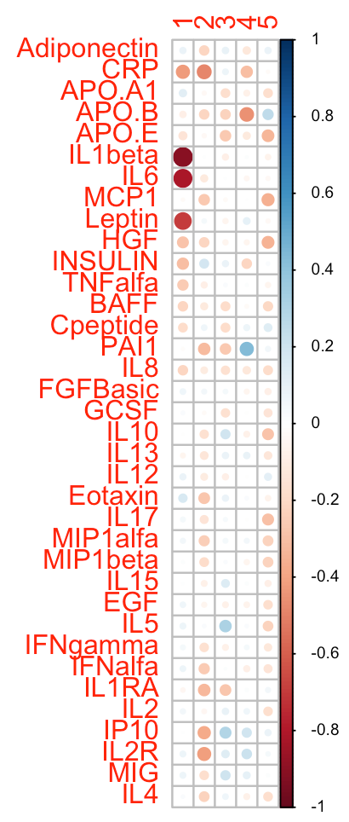
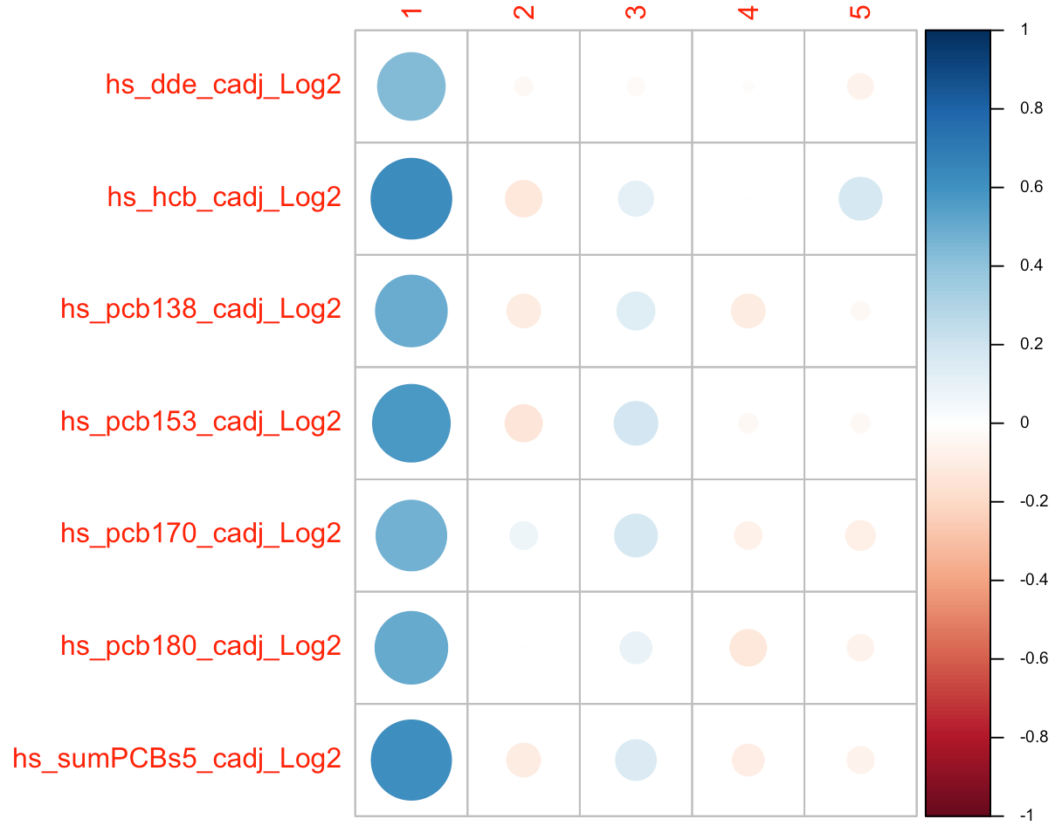
CCA: adjust for cohort
Cohort adj Proteome, cx1
Cohort adj Postnatal exposome, cx1
Notes:
The scores returned by the analysis will just be the sum (or average) of the linear combinations from each dataset.

Slide 33
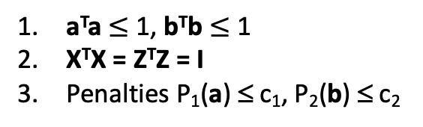
Sparse CCA (sCCA)
Goal: Find linear combinations of high-dimensional (X,Z) that are maximally correlated
X_{nxp}
a
Z_{nxq}
b
Xa
Zb
Step 1. Columns of X, Z, Mean 0, var 1
Step 2. max a^{T}X^{T}Zb subject to:
Witten et al.
Biostatistics (2009)
a^{T}a $≤$ 1, b^{T}b $≤$ 1
X^{T}X = Z^{T}Z = I
Penalties P₁(a) ≤ c₁, P₂(b) ≤ c₂
…
Zb₁
Zb₂
Xa₁
Xa₂
33
Notes:
We have the same goal as before, of finding sets of canonical variables that are maximally correlated these are linear combinations of high-dimensional X,Z matrices.
Step 1., like before, is to standardize the columns of X and Z
Step 2. is to maximize the correlations between Xa and Zb
Subject to the following constraints.l
In high dimensions,
1. put constraints on the weight vectors a, b
2. constrain variance matrices X^{T}X, Z^{T}Z to be identity
3. Penalties P1(a), P2(b), constrain the coefficients, a, b.
I will describe two common penalties next.

Slide 34
sCCA
3. Penalties: P₁(a) ≤ c₁, P₂(b) ≤ c₂
Gene Expression
a
1. Lasso:
P₁(a) = Σ_{i}|a_{i}|
Sparsity
_{DNA Copy Number}
b
2. Fused Lasso
P₂(b) = Σ_{i}|b_{i}| + Σ_{i}|b_{i} – b_{(i-1)}|
Sparsity & Smoothness
34
Notes:
Penalties for vectors a, b, constrain the coefficients.
A common penalty is Lasso.
This penalty enforces sparsity, many coefficients are shrunk to 0 (feature selection)
There is a variant of Lasso used when the data have a natural ordering and smoothness is expected
It is called the Fused Lasso. The first term, is the L1 constraint, and does variable selection.
The second term shrinks neighboring coefficients to be similar. Neighboring coefficients are similar, that imposes smoothness. Copy number alterations along chromosomes occur over regions, making the copy number in a region smooth.

Slide 35
Summary
CCA identifies linear combinations of variables that are correlated
In high-dimensions, apply constraints -> Sparse CCA
Sparse CCA extends to > 2 data types, Sparse multiple CCA
Sparse supervised CCA for predicting outcome

Slide 36

Cluster Analysis is exploratory
Strong cluster signals will persist under many different algorithms/metrics
Validate and interpret your results

Slide 37
Labs
Clustering Part 1: Exposome 3. Clustering COAD
Descriptive Stats 1. PCA Gene Expression
PCA 2. PCA DNA methylation
K-means 3. Sparse CCA
CCA 4. PCA concatenated data
Clustering Part 2: Exposome + Proteome
CCA
Characterizing canonical variables
PCA
CCA after covariate adjustment

